Slide 1
Conjecture and Proof
Converse, Inverse and Contrapositive Statements. Proof by Contradiction and the Pigeon-Hole Principle.

Slide 2
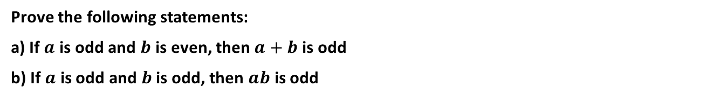
Cambridge Ex 6A Example 1
Prove the following statements:
a) If $a$ is odd and $b$ is even, then $a+b$ is odd
b) If $a$ is odd and $b$ is odd, then $ab$ is odd

Slide 3

Cambridge Ex 6A Q1

Slide 4
Cambridge Ex 6A Example 2
Let $p, q ∈ℤ$ such that $p$is divisible by 5 and $q$ is divisible by 3. Prove that $pq$ is divisible by 15

Slide 5

Cambridge Ex 6A Q3

Slide 6
Cambridge Ex 6A Q5

Slide 7
Cambridge Ex 6A Q6

Slide 8
Cambridge Ex 6A Example 3
Let $x, y$ be any two positive real numbers. Prove that if $x>y$ then $x^{2}>y^{2}$

Slide 9
Cambridge Ex 6A Q10

Slide 10
Cambridge Ex 6A Example 4
Let $x, y$ be any two positive real numbers. Prove that $\frac{x+y}{2}≥\sqrt{xy}$

Slide 11

Cambridge Ex 6A Q11

Slide 12
Cambridge Ex 6A Example 5
Every person on an island is either a knight or a knave. Knight always tell the truth and knaves always lie.
Alice and Bob are residents on the island. Alice says “We are both knaves”. What are Alice and Bob?

Slide 13
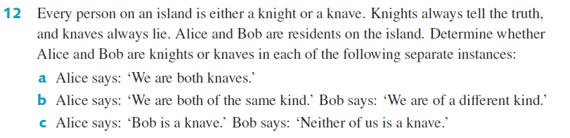
Cambridge Ex 6A Q12

Slide 14
Cambridge Ex 6A Q12

Slide 15
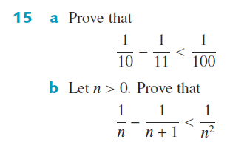
Cambridge Ex 6A Q15

Slide 16
Independent Practice
Cambridge Ex 6A

